Slide 1

Guide : Prof.Junaid Mandviwala

Slide 2
Major Project
Shivam Shere (211A020 /58)
Krishnakant Choudhary (211A018 /09)
Sohail Ansari (211A015 /03)
Saif Ansari (211A011 /02)
Group Members:

Slide 3

ABSTRACT
The stock market has always been a promising avenue for lucrative investing, but most of the profit making depends on the analysis of the current and past market scenario followed by subsequent predictive actions.
The currently overblown market economy has given rise to numerous variables which need to be considered before making a beneficial transaction in the stock market.
Manually analysing all these variables and affecting factors is too cumbersome and error prone.
Therefore, a Machine Learning approach is best suited for analysis of such a seemingly chaotic system.

Slide 4

WHAT IS MACHINE LEARNING ?
Machine Learning is a field of study that gives the computers the ability to learn without being explicitly programmed.
To be explained more formally, it can be defined as,
A computer program is said to learn from experience E with respect to some class of tasks T and performance measure P, if its performance at tasks in T, as measured by P improves with experience E.
For Example : (playing chess)
E = the experience of playing many games
T = task of playing chess
P = probability that the program will win the next game.
The field of Machine Learning is vast and plays a key role in wide range of critical applications.
Predicting the stock market involves predicting the closing prices of a company’s stock for any given of days ahead.

Slide 5


Software
Data: Dataset is collected in the form of csv file from Yahoo finance API.
OS: Any operating system with a browser support for frontend application.
Python: It is a programming language which is most commonly used for making AI and ML solutions which will be used in our backend server.

Slide 6
Libraries
Numpy: This library will allow us to perform efficient computing which is needed for predication calculation. This library is highly optimized to do mathematical tasks of training and scaling datasets.
Pandas: It is used for data pre-processing and preparation. This library will be used to process and structure data which will be used by the ML training model.
Yfinance: This API is where stock data values are extracted from the Yahoo Finance website which provides us with real time stationary data and analysis are made based on these values imported.

Slide 7
Data Visualization Libraries: Libraries like matplotlib and Seaborn are some examples of the such libraries which are used to plot and analyze the lines or combinations observed during the prediction process.
Streamlit: Streamlit is an open-source framework to rapidly build and share beautiful machine learning and data science web apps in a short time.
Jupyter Notebook :

Slide 8
Problem Statement
Stock price prediction is one of the most challenging tasks in finance due to the stock market's non-linear patterns. Accurate forecasts are crucial for investors, traders, and financial institutions to make informed decisions and manage risks.
In this problem, Our primary challenge is to identify a robust predictive model that can accurately forecast stock prices by comparing LSTM, SVM, & RF models on accuracy Metrics , while accounting for the complexities and offering reliable decision-making insights.

Slide 9
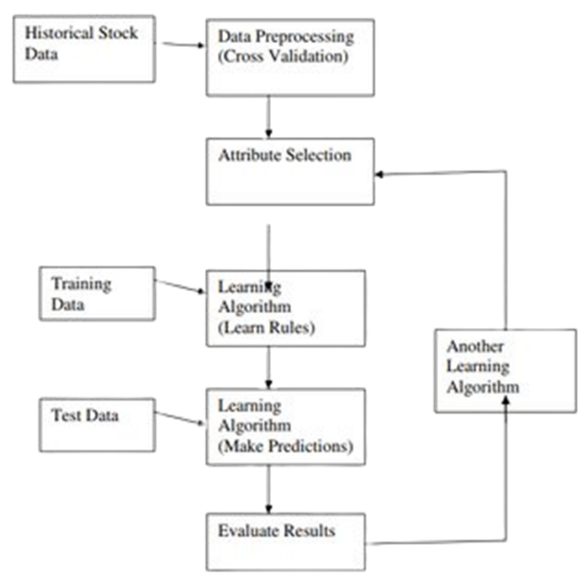
Implementation Plan

Slide 10
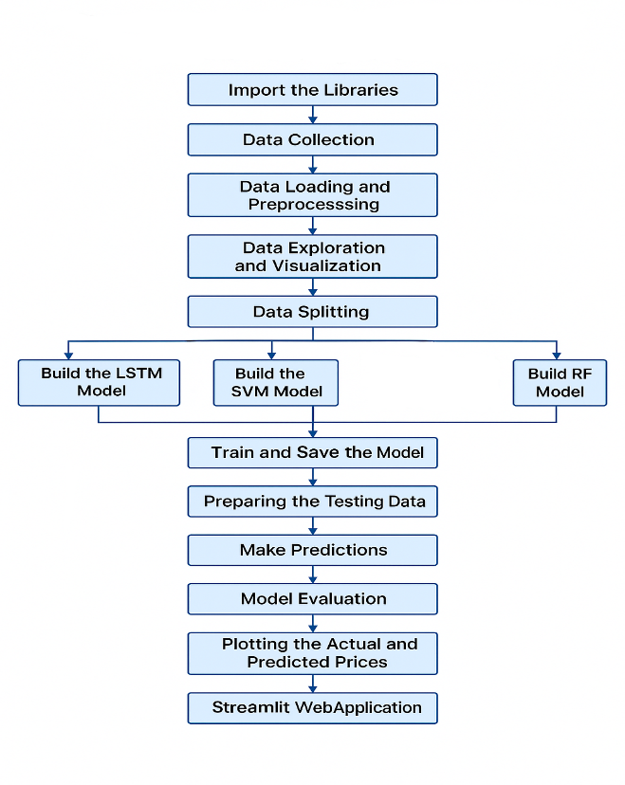
Prediction Methodology
Model training block diagram:

Slide 11
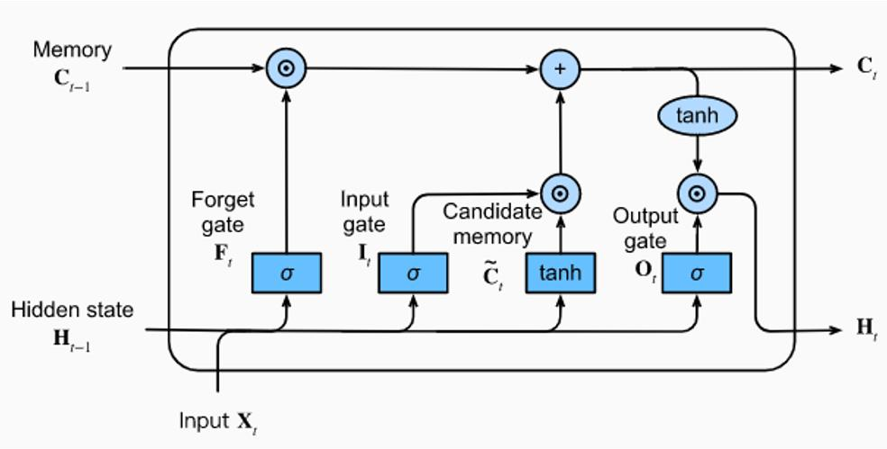
COMPARISON OF EXISTING METHODS
1. Long Short Term Memory (LSTM):
LSTMs are a type of Recurrent Neural Network for learning long-term dependencies. It is commonly used for processing and predicting time-series data.

Slide 12
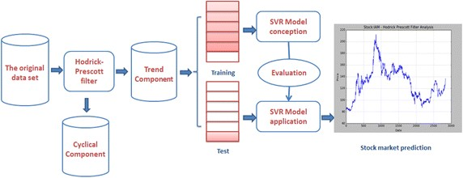
2. Support Vector Machine (SVM):
Support Vector Machines (SVM) are powerful supervised learning algorithms that can handle both classification and regression tasks. When applied to stock price prediction, a specialized variant known as Support Vector Regression (SVR) is used. Unlike conventional regression models, which aim to minimize the difference between predicted and actual values, SVR focuses on finding the best hyperplane that fits within a defined margin of tolerance, denoted as epsilon.

Slide 13
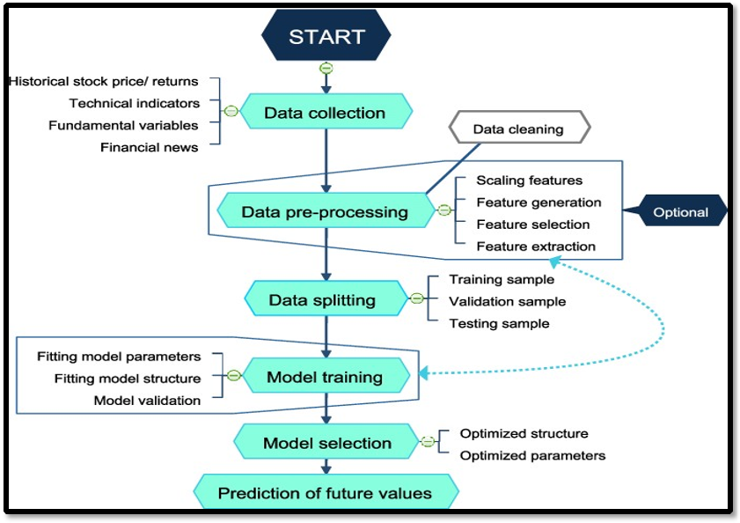
3. Random Forest (RF):
Random Forests is an ensemble learning method primarily designed for classification and regression tasks. The technique is based on the construction of multiple decision trees during the training phase. Each decision tree is trained on a random subset of the dataset and features, introducing diversity in the model. By aggregating the predictions of all the trees either through majority voting for classification or averaging for regression Random Forests enhance overall accuracy and robustness. This approach reduces the risk of overfitting, which is common in single decision trees, and improves generalization on unseen data.

Slide 14
Challenges And Solution
Data Preprocessing and Feature Selection:
Challenge: Proper “data preprocessing” (e.g., handling missing values, scaling, normalizing data) and “feature selection” were critical for the success of each model. Incorrect preprocessing could lead to poor model performance.
Solution: The project relied on preprocessing techniques like “Min Max scaling” and proper feature selection to enhance model performance. For models like Random Forest, feature importance helped in identifying the most relevant features for prediction.
Data Complexity:
Challenge: Stock market data is highly volatile and exhibits non-linear patterns, making it difficult to model accurately. While LSTM was effective at handling these complexities, models like SVM & RF struggles because they are better suited for linear, stationary data.
Solution: Machine learning models, particularly LSTM and Random Forest, were able to capture these complex patterns better than traditional models like SVM.

Slide 15
Future Work
Hybrid models combining:
The combination of LSTM and Random Forest OR LSTM & SVM OR SVM & RF.
Ensemble learning techniques:
The techniques like (Bagging, Boosting) to improve robustness and reduce errors.
Advanced Hyperparameter Tuning :
It helps to achieve optimal model performance without extensive manual effort.

Slide 16
CONCLUSION
In the project, By using machine learning algorithms and historical data, the application can provide predictions on future stock price. Various machine learning based models are used for predicting the stock price of companies. However, it's important to keep in mind that stock market predictions are not always accurate, and there are many factors that can influence the market.

Slide 17

Thank you

